Slide 1
Rationale and Purpose of Day 2
Gérard Bricogne
ISPyB-MXCuBE Meeting
Diamond Light Source, 18 November 2025

Slide 2
Rationale
Global Phasing (GPhL for short) is in the 10th three-year Phase of the activities of its Consortium of Drug Discovery companies (Phase X).
We have been part of the MXCuBE and ISPyB collaborations since they began, and have been actively contributing to MXCuBE since 2017 in relation to the deployment of our data collection Workflow
We have had a working connection with the PDB since 2020 to add anisotropic data statistics and attributes to the mmCIF dictionary
Our interactions in these three streams of activities have so far been kept separate: now seems a good time to bring them together
A bit of history may help understand the relationship between these streams, and the prospects for constructive exchanges around them

Slide 3
1. Early Phases: individual applications
We (GPhL) were writing and distributing individual application programs (SHARP and BUSTER, later autoPROC) that Members would invoke through their own scripts, directly providing these programs with the necessary input files and using their output in their own IT environments, typically structured around their corporate LIMS
This was in keeping with the way in which diffraction data were acquired, with users physically travelling to synchrotrons, driving their experiments through the beamline GUI, with enough time to screen each crystal and plan a strategy before launching the data collection
The diffraction images were transferred to the users’ companies on disks (with a back-up copy being kept for variable lengths of time on the synchrotron’s file system) and were processed by the users on their own computers, e.g. using autoPROC.
All subsequently derived results (experimentally phased maps, refined atomic models, and ligand poses when applicable) were also generated within each company’s IT infrastructure

Slide 4
2. Wrappers for use in corporate pipelines
To facilitate the use of our software within the increasingly automated environments of corporate “pipelines” (rather than manually by the user), an effort was made to provide standardised wrappers around our own applications (e.g. autoSHARP) and even to start assembling pipeline segments combining the invocation of several of our applications within a single construct (e.g. Pipedream, that invokes sequentially autoPROC, BUSTER, RhoFit and buster-report).
All processing and further exploitation of the diffraction data was still done “at home”.

Slide 5
3. A watershed moment in the evolution of MX
Pixel array, or hybrid photon counting, detectors (PADs or HPCs), introduces in the early 2010’s
made data collection times much shorter by using continuous rotation and by achieving a higher DQE than the CCDs that preceded them
made the volume of raw diffraction images per dataset much larger by making it advantageous to use “fine slicing” together with processing software based on 3D reflection profiles to increase data quality
A major knock-on effect was that each synchrotron shift produced much greater numbers of datasets, each of which consisting of many more diffraction images, than before. This made the previous mode of operation - “collect at synchrotron, process at home” - unsustainable, leading to the creation and routine operation of auto-processing pipelines at synchrotrons in the mid 2010’s.
Another equally important impact was that, with data collection times per dataset having become so short, every step between mounting a sample on the goniometer and starting data collection came under unprecedented time pressure and had to be radically streamlined, thus excluding any possibility of planning a data collection strategy for each crystal on the basis of an initial characterisation, especially if that strategy were to involve the active use of a multi-axis goniometer.

Slide 6
4. Paradigm shift and its far-reaching implications
Although users were still able to control their experiments via the beamline GUI, the speed incentive led to the majority of data collections being performed according to minimalistic protocols (“collect first, ask questions later”);
The execution of autoPROC was no longer controlled directly by the users, nor by the users’ own scripts fine-tuned to their internal company pipeline, but by wrappers written by the local software teams at each synchrotron, typically with little or no input from us, and with a tendency to enforce a “Procrustean bed” policy of keeping the wrappers of the different processing programs used in the various available pipelines as similar as possible;
The users’ ability to customise the precise manner in which autoPROC was to be run on their datasets by specifying non-default options or keywords was much reduced compared to running the program “at home” as before, in a way that varied from one synchrotron to another, the only vehicle available for conveying such information being the Diffraction Plan optionally attached to each sample;
The delivery of autoPROC results to users was similarly subject to whatever assumptions and restrictions had been built into the local auto-processing wrappers, that could be counter-intuitive, or even misguided, and quite variable from one synchrotron to another;
Of particular concern to us was the presentation of summaries of results and data quality metrics in the frontends of the synchrotron databases, as well as the built-in limitations in the structure of these databases, that created a great deal rigidity towards the properly organised storage and presentation of new types of results or metrics.

Slide 7
5. Adapting to the new paradigm
Counteracting the shift towards minimalistic experiments in (1) was the motivation for developing our data collection Workflow, under the motto of “Reintroducing expertise without loss of automation”, for which we joined the MXCuBE Collaboration; while the practice of collecting datasets on suboptimal samples that were then fed directly into auto-processing provided a strong incentive to extensively robustify autoPROC against flawed datasets, e.g. blank image ranges where the crystal had come out of the beam.
The drastic changes in (2) to (5) regarding the way autoPROC was being run on users’ data broke the hitherto existing links (a) between us and the users, introducing a further hindrance to their providing us with feedback, and (b) between the users and autoPROC results, as they were now only given access to a subset of its output files (not always sensibly selected) loaded by the local autoPROC pipeline into the synchrotron’s database and referenced in its front end.
This made it absolutely necessary for GPhL to actively engage with the software teams of as many synchrotrons as possible, to ensure that the deployment of autoPROC in their auto-processing pipelines was done in the best possible manner - for the greatest benefit to the users, not just for the greatest convenience of their pipeline developers. We thus joined the Collaboration on the ISPyB synchrotron logistics database software.

Slide 8
6. Driving change from within (at least, trying to)
ISPyB being an essential hub for synchrotron logistics, we made sure to document when our needs were not met by the current software and to request changes
The MX software teams at synchrotrons often being chronically under-resourced, and therefore materially unable to fulfil external requests for new features, access to their core developers has been crucial towards the accommodation of our many “disruptive” innovations, such as
our data collection Workflow (requiring its connection to beamline control via MXCuBE, and the proper storage and organisation of the multi-orientation datasets it produces and their associated processing results in ISPyB).
the addition of the STARANISO analysis results into the autoPROC output (requiring an enlargement of the list of processing results for a given sample that were to be stored in the ISPyB database and displayed through its frontend).
The recent evolution, during the past five years, of data collection and processing towards remote user access and unattended data collection facilities has further increased the degree to which our data-related developments are delivered to users through “plumbing” that invokes them within the operations of large infrastructures. This made even more vitally important our close involvement with the relevant “plumbers” to maintain an up-to-date picture of how these operations are designed and run, and to try and influence it in useful directions

Slide 9
9. Relations with the wwPDB …
Another major entity that sets stringent boundary conditions within which our software must operate is the wwPDB, the end point of all structural results obtained by MX.
The contents of deposition files must conform to validation criteria based on an extensive ontology embodied in the PDBx/mmCIF dictionary, elaborated over decades.
Our own work was not directly concerned with these matters until we developed the STARANISO program, created the public Web server making its execution available to the community, and enabled autoPROC to incorporate the results of the STARANISO anisotropy analysis into its output. We were then confronted with the fact that there was no possibility to deposit the results of this analysis, while many investigators had found STARANISO so useful that they felt its output should be part of their depositions.
A “PDBx/mmCIF Deposition SubGroup on Data Collection” was formed” on October 1st, 2020. Thanks to regular working VCs with the RCSB team and other interested parties, we had by March 2021 a set of 50 modifications and extensions to the mmCIF dictionary that were able to capture, and thus archive, the full information content of the STARANISO output, along with improvements over previous dictionary versions regarding the deposition of richer experimental data and metadata for anomalous and unmerged measurements.

Slide 10
… going forward
This interaction with the wwPDB gave us a detailed view of the mechanisms available for including richer and richer information into deposition files created by autoPROC and BUSTER, to the point that we would claim that our deposition-ready mmCIF files are second to none in terms of data and metadata content.
We have been invited to join two collaborative “FAIRification” projects during Phase X:
the first one aims at developing an automated data-harvesting framework to transfer experimental metadata from two large UK facilities (a synchrotron and a cryo-EM centre) through structure determination pipelines to the OneDep frontend at the PDBe, i.e. at extending the “plumbing” at these infrastructures towards the deposition system.
the second project, jointly funded by the NSF and the BBSRC for a period of three years, developers of structure determination software packages (Phenix, CCP4, GPhL and CCP-EM) will be granted access to the wwPDB’s OneDep software tools so that they use these in their own software to improve the quality of the overall (experimental and analytical) metadata accompanying 3D structures deposited into the PDB – again an effort dedicated to connecting the “plumbing” of large structure-producing entities directly to the input socket of the wwPDB itself, namely OneDep.
This will enable us to extend our attention and effort towards ensuring that the results produced by our software are delivered into the wwPDB archive without any loss in the contents, that we have separately been endeavouring to make as rich as possible, with a view to enabling intelligent data mining programs to reliably assess up-front the potential usefulness of any PDB entry towards a specific Machine Learning process.

Slide 11
From Rationale to Purpose
From an introvert point of view: we have not aimed at curing all the ills in the world of MX - we have simply tried to clear the path for the optimal use of our diffraction-related software (Workflow and autoPROC) wherever it is blocked by structural limitations within the synchrotrons where it is deployed or within the PDB’s archiving mechanisms.
From an extrovert point of view: we are aiming to give the community the benefit of our full network of scientific contacts and interactions to facilitate a shift towards evermore productive forms of the ecosystem of providers and users (esp. industrial users) of the wonders of MX.
It seems natural to us to begin by improving communication between drug discovery companies, synchrotrons and the PDB in some focussed, specific areas.

Slide 12
Phase X: Do even better what MX does best
Title
Advanced software for optimally exploiting the unique capabilities of MX to provide high-volume, high-quality input to SBDD assisted by AI/ML
Executive Summary
At a time of rapidly shifting boundaries in Structural Biology between MX (Macromolecular Crystallography) and cryo-EM (Electron Cryo-Microscopy) as primary structure determination techniques on the one hand, and between the recourse to prediction-based versus experimentally-derived structural models on the other, GPhL (Global Phasing) is choosing to dedicate its Phase X activities to further enhancing the performance of MX in the areas where it retains unmatched capabilities, namely as the most efficient engine for producing high volumes of high-quality structural information for SBDD (Structure Based Drug Discovery), accompanied by a wealth of metadata enabling the optimal use of that information by ML (Machine Learning) to support further progress in the use of AI (Artificial Intelligence) methods in the drug discovery process.

Slide 13
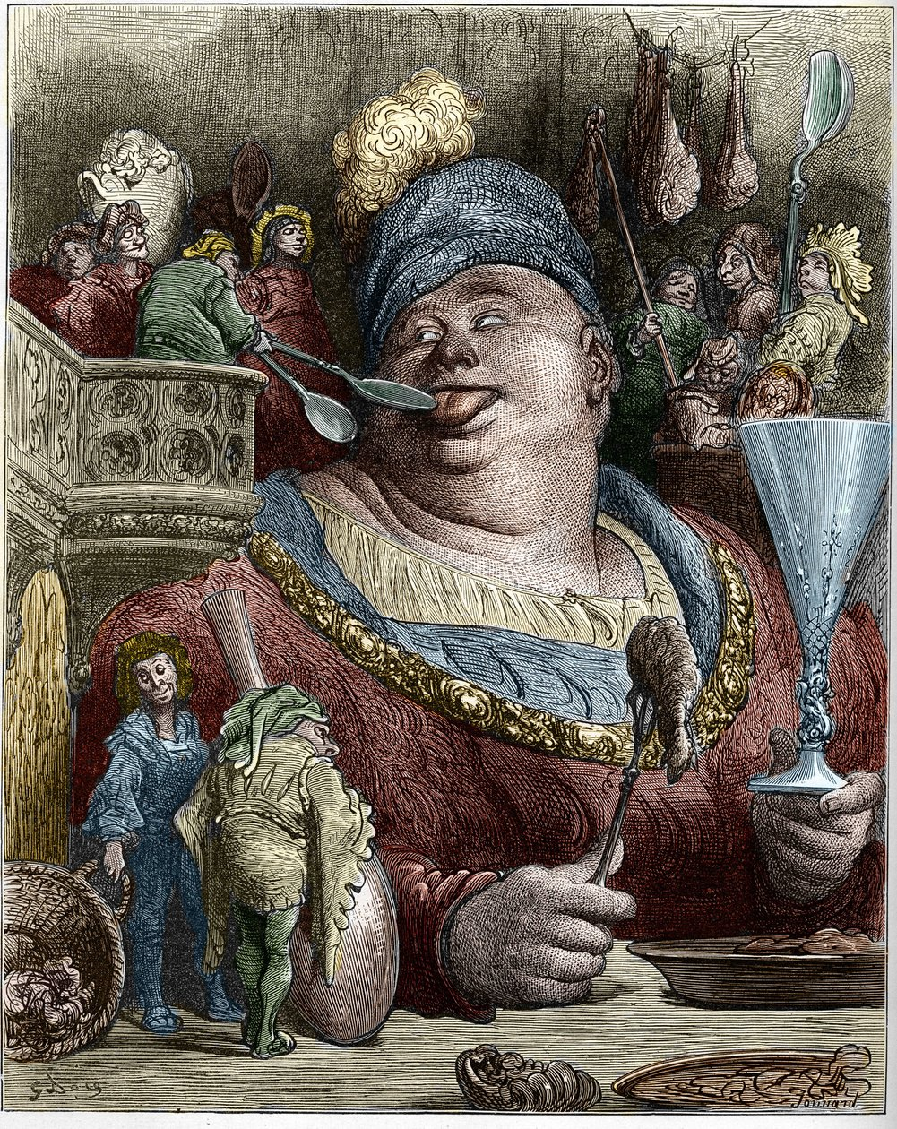
Phase X: (a selection of) main activity areas
Contributing to the standardisation of logistics across numerous synchrotrons, the lack of which is a well-known cause of efficiency limitations in the overall operations of MX for SBDD, as these are increasingly multi-synchrotron operations.
Pushing up the priority of maximising diffraction data quality from the ground up, with the rationale that the less informative the experimental data, the greater the risk of an insidious drift towards recycling predictions not “fact-checked” by diffraction data.
Contributing to the implementation of automated protocols to facilitate the enrichment of PDB depositions on a massive scale directly from the data and metadata stored at synchrotrons and used by structure determination programs, with a view to feeding ML engines with experimentally supported structural information (“FAIRification”).

Slide 14
What could this Day 2 gathering contribute?
We will propose the creation of an Interoperability Working Group, with an active participation from interested industrial partners, aiming at an initially limited set of goals such as
Assessing fitness for purpose of implementations by the standards of their own operations
Actively using MXLIMS-based shipment forms and an MXLIMS-based API for retrieving results
Taking part in developer VCs and code reviews
Guiding the writing of common new tools using the MXLIMS standard
We will propose to consider the Interoperability question from a large-scale point of view
FAIRification aims at using synchrotron archives to create rich-metadata entries more directly useable for ML
It would be unhelpful to propagate the current heterogeneity of data access modes at synchrotrons into a multiplicity of FAIRification initiatives, one for each synchrotron
We need Interoperability for FAIRification just as much as for sample shipment and results retrieval
Leaving it to the PDB to solve this problem may not be the best option in view of its reluctance to open up its deposition protocols and code to external contributions
We will propose an Open Quality Assurance initiative, jointly with industrial users
These proposals call upon a pre-competitive spirit on the part of the synchrotrons involved

Slide 19
Now to the real speakers …

